Slide 1
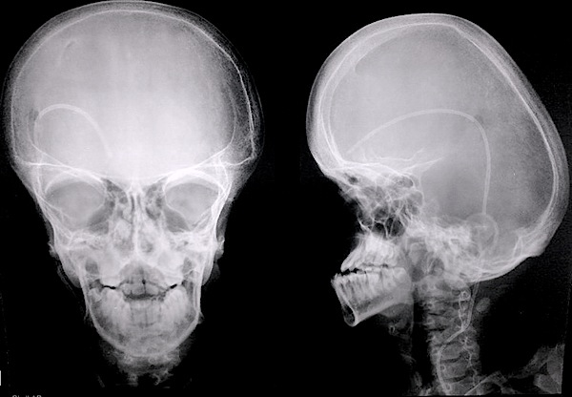

Apert Syndrome
Skeletal abnormalities caused by mutations in the FGFR2 gene
Sophia Lenzmeier
Notes:
https://app.emaze.com/@ATTQRROF#1

Slide 2

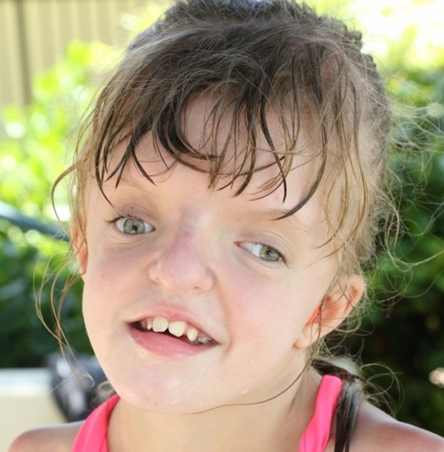
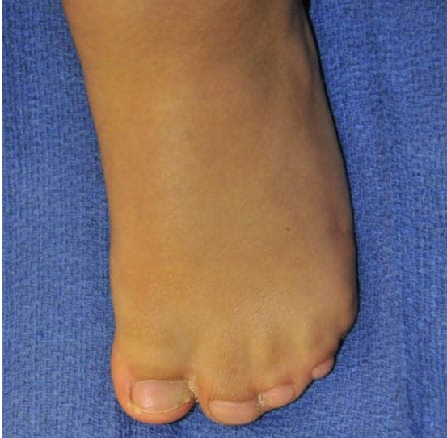
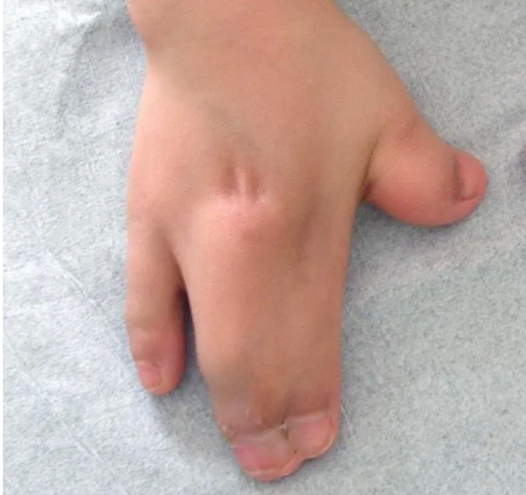
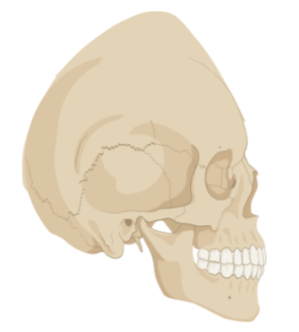

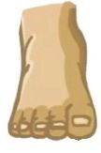

Key features of Apert Syndrome
acrocephalosyndactyly
tall or peaked skull & fused digits
Notes:
Tall or peaked skull, fused digits including fingers and toes
Image source: https://www.youtube.com/watch?v=Vsa0dX-s-po
Skull made with biorender

Slide 3
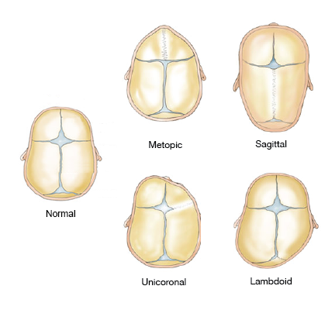
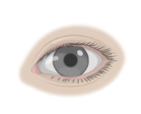
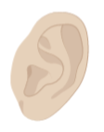
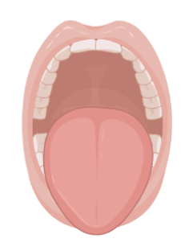
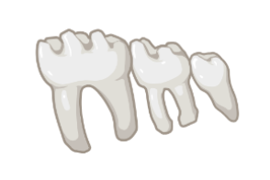

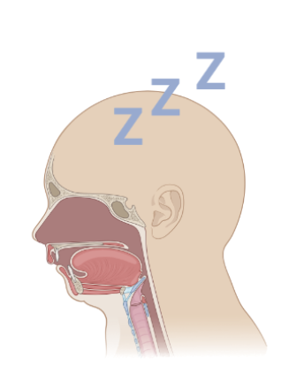
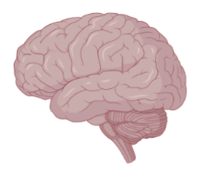
Fusion of cranial sutures and associated symptoms
Sutures normally act as expansion joints allowing for stretching when the brain grows
Notes:
https://cranioutah.com/diagnoses/craniosynostosis/

Slide 4

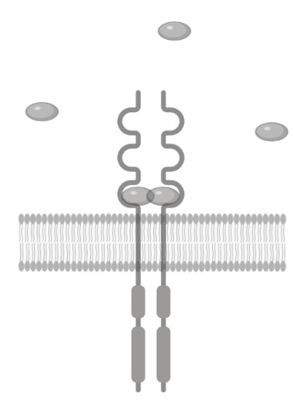
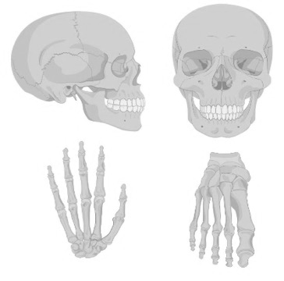

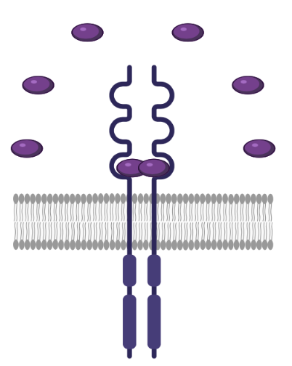
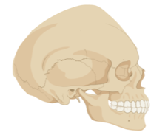

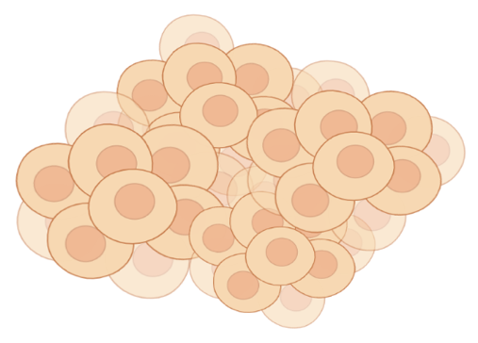

Fibroblast Growth Factor Receptor 2 in Apert Syndrome
FGFR2
Immunoglobulin C2
Transmembrane
Tyrosine Kinase
normal
mutant
Notes:
Increased binding affinity

Slide 5
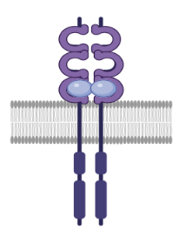
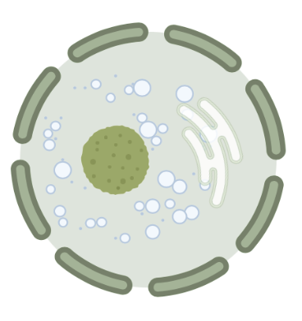
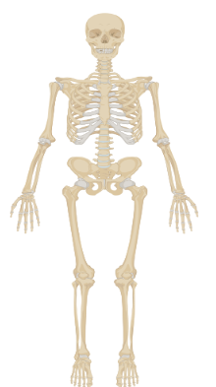

Role of FGFR2
Molecular Function
Cellular Component
Biological Process
Growth factor receptor binding
Receptor-receptor interaction
Catalytic activity
Protein tyrosine kinase activity
Cell junctions
Nucleoplasm
Extracellular Matrix
Cell surface
Bone cell proliferation
Cranial skeletal system development
Embryonic skeletal system development
Notes:
https://www.sciencedirect.com/science/article/pii/S0022202X15344328 growth factor binding protein
https://www.proteinatlas.org/ENSG00000066468-FGFR2/cell FGFR2 detected in Cell junctions, Nucleoplasm and Vesicles;
3. https://www.ck12.org/biology/bone-growth/lesson/bone-formation-advanced-bio-adv/ bone cell proliferation in embryonic development
Note: receptor-receptor interaction means that the protein forms of a dimer of two FGFR2 subunits to function as a receptor

Slide 6
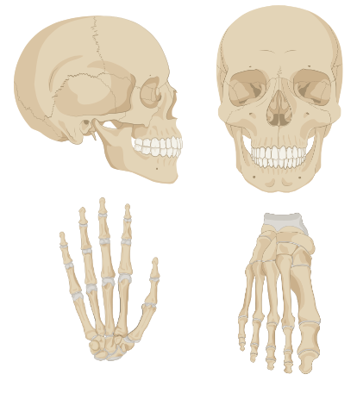
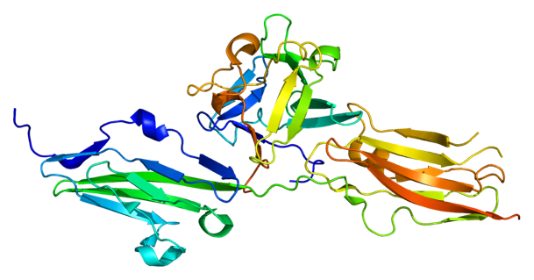

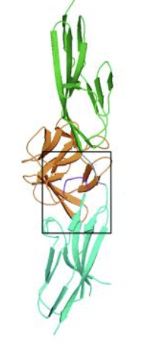


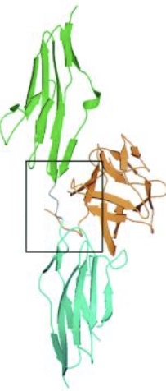

The role of FGFR2 is not fully understood
The role of the immunoglobulin domains of FGFR2 in mediating bone cell proliferation and differentiation during embryonic development remains unclear
Notes:
https://en.wikipedia.org/wiki/Fibroblast_growth_factor_receptor_2
https://pubmed.ncbi.nlm.nih.gov/11390973/

Slide 7
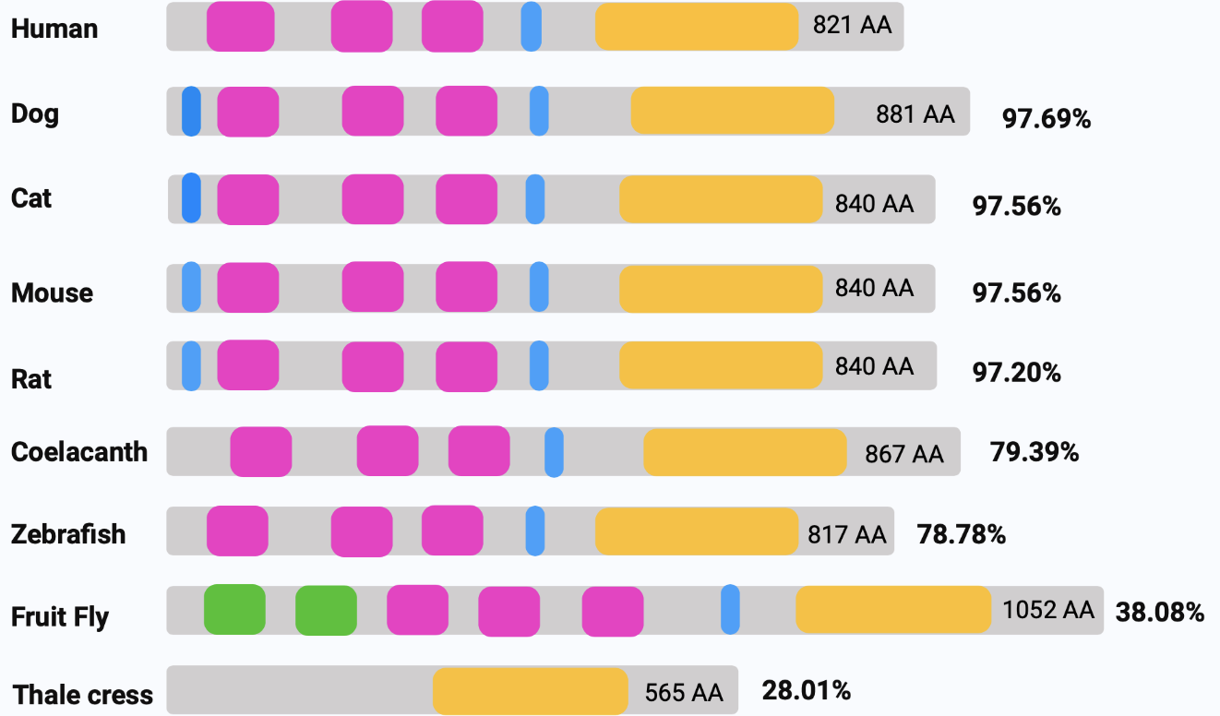
FGFR2 is conserved across species
IGc2
Tm
TyrKc

Slide 8

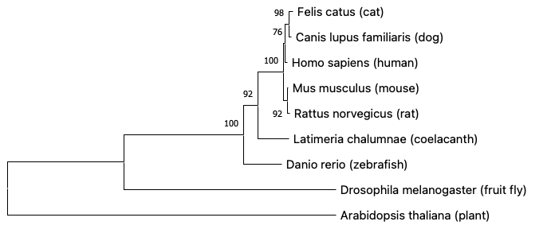








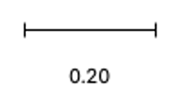
FGFR2 has been conserved over time
MUSCLE aligning: Maximum Likelihood

Slide 9
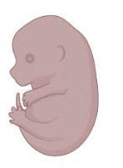
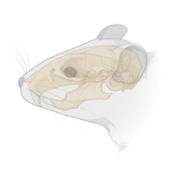
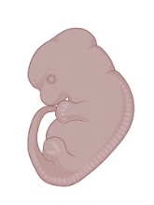
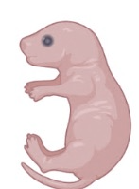
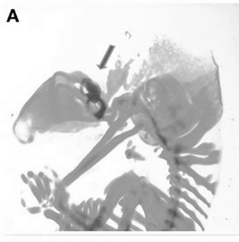
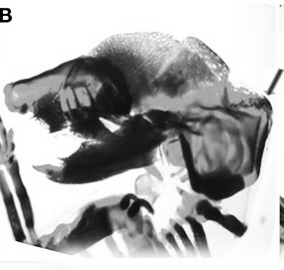
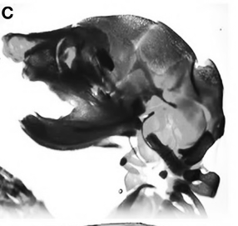
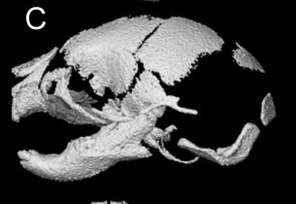
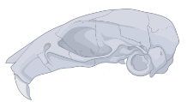
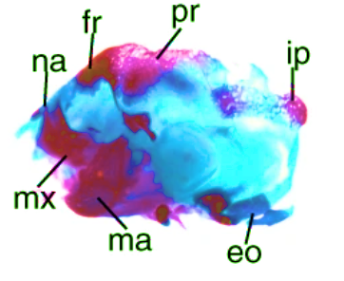
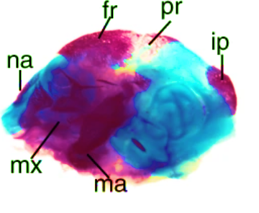
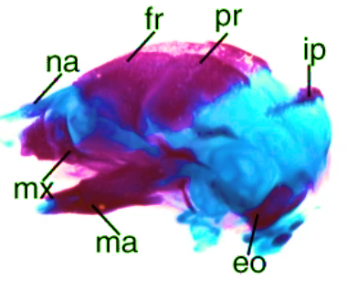
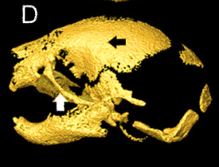
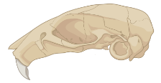
Mice are the best model organism for bone development
Stages of development
Normal development
Abnormal development
Jiang Y. et al. 2019
Wany Y. et al. 2010
Notes:
Richtsmeier, Joan & Lee, Chanyoung. (2015). A Computational Analysis of Bone Formation in the Cranial Vault in the Mouse. Frontiers in Bioengineering and Biotechnology. 3. 10.3389/fbioe.2015.00024. Retrieved from: https://www.researchgate.net/publication/273789038_A_Computational_Analysis_of_Bone_Formation_in_the_Cranial_Vault_in_the_Mouse
https://www.ncbi.nlm.nih.gov/pmc/articles/PMC2838826/
https://www.nature.com/articles/s41368-018-0040-z

Slide 10
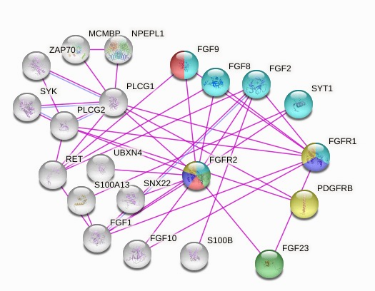
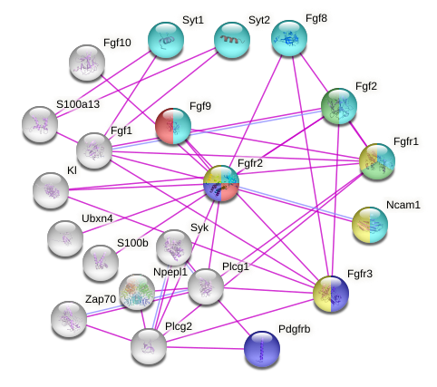
Human and mouse FGFR2 protein interactions
Human
Mouse
Positive regulators of developmental growth
Immunoglobulin domain
Regulators of osteoblast differentiation
Skeletal system morphogenesis
Embryonic skeletal system development

Slide 11

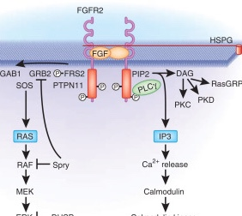
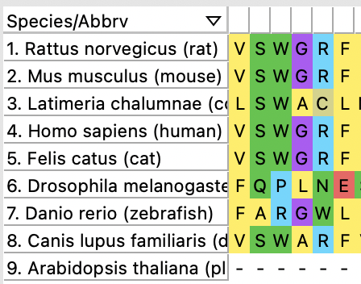
Primary Goal
To understand the role of FGFR2 in bone cell proliferation and differentiation during embryonic development
Aim 1
Aim 2
Aim 3
Identify conserved amino acids of FGFR2 that are critical for bone cell growth during development
Identify differentially expressed genes important for bone development in CRISPR/Cas9
FGFR2 mutant mice created in aim 1
Quantify the levels of important proteins involved in skeletal growth during embryonic development
Notes:
https://davetang.org/muse/2013/10/01/position-weight-matrix/
https://www.spandidos-publications.com/10.3892/mmr.2018.9675

Slide 12
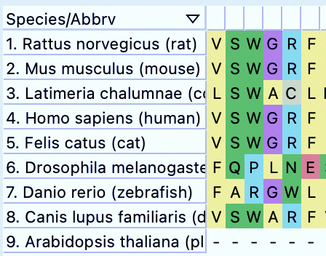
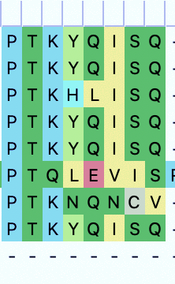
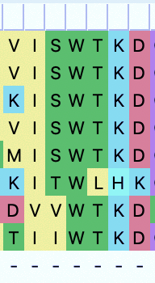
Aim 1: Identify conserved amino acids of FGFR2 that are critical for bone cell growth during development
Serine at positions 134, 233, 274: one in each immunoglobulin domain
Hypothesis: Mutations in conserved amino acids in the immunoglobulin domains will affect bone growth in early stages of development
Multiple sequence alignment
CRISPR/Cas9
Screening
Notes:
https://www.cancertodaymag.org/Pages/Fall2019/The-Promise-of-CRISPR.aspx

Slide 13
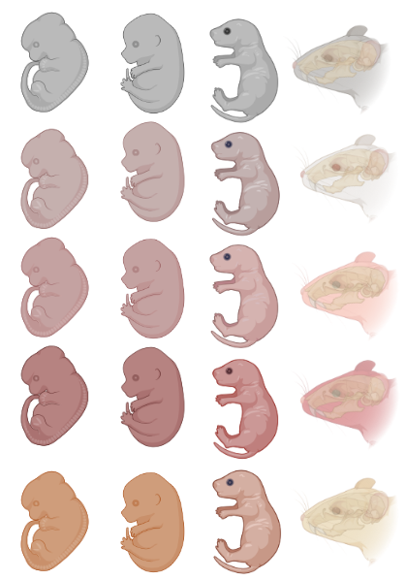



Aim 1: Identify conserved amino acids of FGFR2 that are critical for bone cell growth during development
Wildtype
FGFR2
mutant
S134
S233
S274
Multiple sequence alignment
CRISPR/Cas9
Screening
Notes:
https://www.cancertodaymag.org/Pages/Fall2019/The-Promise-of-CRISPR.aspx
Immunohistostaining & microscopy

Slide 14

Aim 1: Identify conserved amino acids of FGFR2 that are critical for bone cell growth during development
Wildtype
FGFR2
mutant
S134
S233
S274
Hypothesis: Mutations in conserved serines in the immunoglobulin domains will reduce growth factor affinity and rescue bone growth in early stages of development
Multiple sequence alignment
CRISPR/Cas9
Screening

Slide 15


Aim 2: Identify differentially expressed genes important for bone development in FGFR2 mutant mice
Wildtype
FGFR2
mutant
S134
S233
S274
RNA-seq
GO
CRISPR and Screen
Notes:
http://www.support.illumina.com/content/illumina-marketing/en/informatics/sequencing-data-analysis/rna.html

Slide 16




Aim 2: Identify differentially expressed genes important for bone development in FGFR2 mutant mice
Positive regulation of
developmental growth
Immunoglobulin
domain
Skeletal system
morphogenesis
GD15
WT
mutant
S134
S233
S274
Hypothesis: Differentially expressed genes involved bone cell proliferation will be present in the second trimester of embryonic development which is GD 10–20 in mice
RNA-seq
GO
CRISPR and Screen
Notes:
http://www.support.illumina.com/content/illumina-marketing/en/informatics/sequencing-data-analysis/rna.html
18 different FGFs that bind to 4 tyrosine kinase FGFR receptors (some of which can undergo alternative splicing which assists in more specificity but there still is some overlap in binding)

Slide 17





Aim 2: Identify differentially expressed genes important for bone development in FGFR2 mutant mice
Wildtype
FGFR2
mutant
S134
S233
S274
Hypothesis: Differentially expressed genes involved bone cell proliferation will be present in the second trimester of embryonic development which is GD 10–20 in mice
RNA-seq
GO
CRISPR and Screen
Notes:
http://www.support.illumina.com/content/illumina-marketing/en/informatics/sequencing-data-analysis/rna.html

Slide 18



Aim 3: Quantify proteins involved bone growth during embryonic development
Wildtype
FGFR2
mutant
S134
S233
S274
GO
CRISPR and Screen
iTRAQ
Notes:
https://en.wikipedia.org/wiki/File:Protein_Interaction_Network_for_TMEM8A.png

Slide 19

Aim 3: Quantify proteins involved bone growth during embryonic development
Wildtype
FGFR2
mutant
S134
S233
S274
Hypothesis: Proteins that interact with FGFR2 involved in embryonic skeletal development will be in elevated levels and those with immunoglobulin domains will have reduced levels
GO
CRISPR and Screen
iTRAQ
Notes:
https://en.wikipedia.org/wiki/File:Protein_Interaction_Network_for_TMEM8A.png

Slide 20




Aim 3: Quantify proteins involved bone growth during embryonic development
Wildtype
FGFR2
mutant
S134
S233
S274
WT
mutant
S134, S233, S274
Hypothesis: Proteins that interact with FGFR2 involved in embryonic skeletal development will be in elevated levels and those with immunoglobulin domains will have reduced levels
GO
CRISPR and Screen
iTRAQ
Notes:
https://en.wikipedia.org/wiki/File:Protein_Interaction_Network_for_TMEM8A.png

Slide 21




Summary
Apert Syndrome is caused by a mutation in the FGFR2 gene leading to skeletal abnormalities occurring during embryonic development
The role of FGFR2 in mediating bone cell proliferation and differentiation via the immunoglobulin domains during embryonic development remains unclear
Assessing how the FGFR2 protein interacts with other proteins during development may lead to new findings for potential treatments

Slide 22


Future Directions
Many other craniofacial diseases involve mutations in the FGFR2 gene
&

Slide 23
References
Das, S., & Munshi, A. (2018). Research advances in Apert syndrome. Journal of oral biology and craniofacial research, 8(3), 194–199. https://doi.org/10.1016/j.jobcr.2017.05.006 Retrieved from: https://www.ncbi.nlm.nih.gov/pmc/articles/PMC6107905/
FGFR2 gene: MedlinePlus Genetics. (2020, August 18). Retrieved from: https://medlineplus.gov/genetics/gene/fgfr2/
Jiang, Y., Zhang, S., Mao, C. et al. Defining a critical period in calvarial development for Hedgehog pathway antagonist-induced frontal bone dysplasia in mice. Int J Oral Sci 11, 3 (2019). https://doi.org/10.1038/s41368-018-0040-z
Richtsmeier, Joan & Lee, Chanyoung. (2015). A Computational Analysis of Bone Formation in the Cranial Vault in the Mouse. Frontiers in Bioengineering and Biotechnology. 3. 10.3389/fbioe.2015.00024. Retrieved from: https://www.researchgate.net/publication/273789038_A_Computational_Analysis_of_Bone_Formation_in_the_Cranial_Vault_in_the_Mouse
Wang Y, Sun M, Uhlhorn VL, et al. Activation of p38 MAPK pathway in the skull abnormalities of Apert syndrome Fgfr2(+P253R) mice. BMC Dev Biol. 2010;10:22. Published 2010 Feb 22. doi:10.1186/1471-213X-10-22
Wenger T, Miller D, Evans K. FGFR Craniosynostosis Syndromes Overview. 1998 Oct 20 [Updated 2020 Apr 30]. In: Adam MP, Ardinger HH, Pagon RA, et al., editors. GeneReviews® [Internet]. Seattle (WA): University of Washington, Seattle; 1993-2021. Retrieved from: https://www.ncbi.nlm.nih.gov/books/NBK1455
Images:
https://app.emaze.com/@ATTQRROF#1
https://biorender.com
https://www.youtube.com/watch?v=Vsa0dX-s-po
https://cranioutah.com/diagnoses/craniosynostosis/
https://knowyourteam.com/blog/2020/04/22/the-4-critical-questions-to-ask-remote-employees/

Slide 24

Questions

