Slide 1
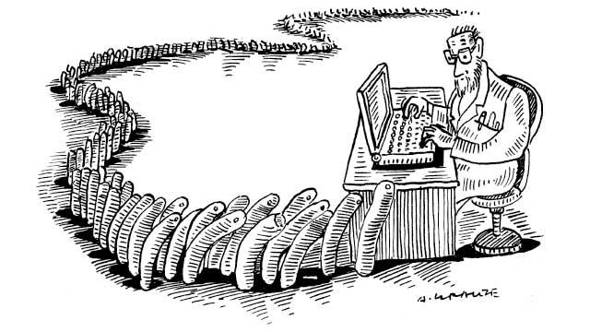
Next Generation Sequencing
Austin Staudinger and Stephen Ortmann

Slide 2
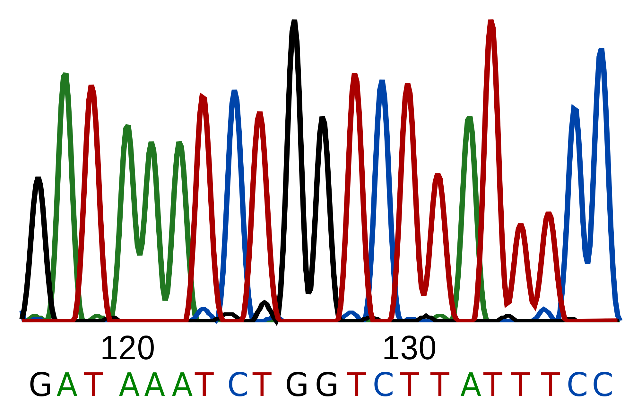
What is Genomic Sequencing?

Slide 3
When did the field of genomics start?

Slide 4
How do these techniques work?

Slide 5
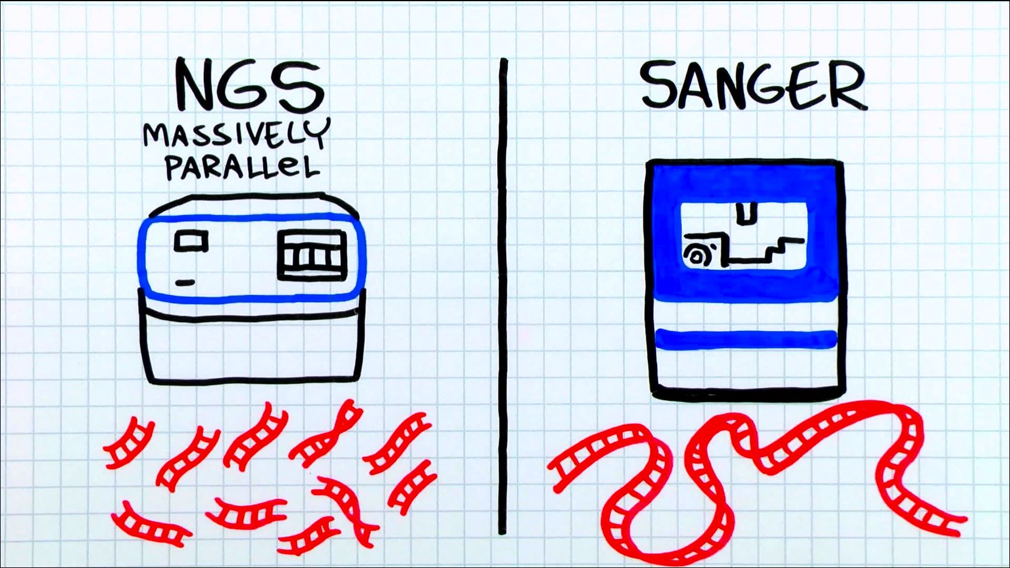
What different kinds of sequencing are there?

Slide 6
First Generation: Sanger Sequencing
Second Generation:
454 & Illumina
Third Generation: whole molecule sequencing!

Slide 7
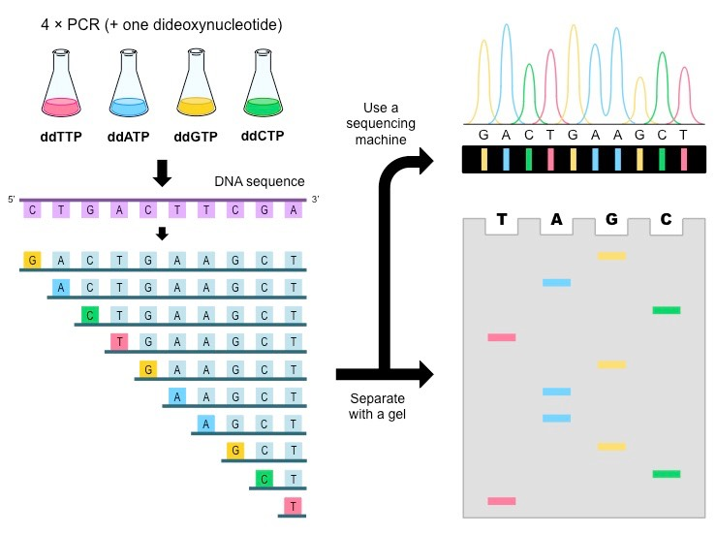
How does Sanger Sequencing work?

Slide 8
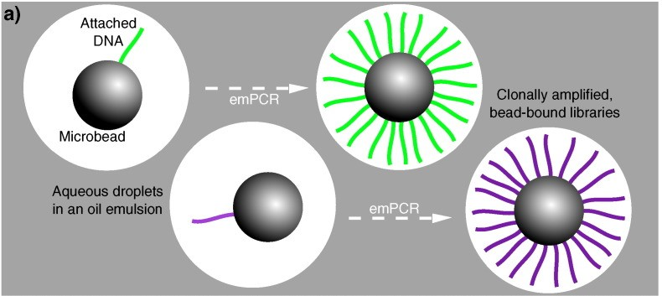
How does 454 sequencing work?

Slide 9
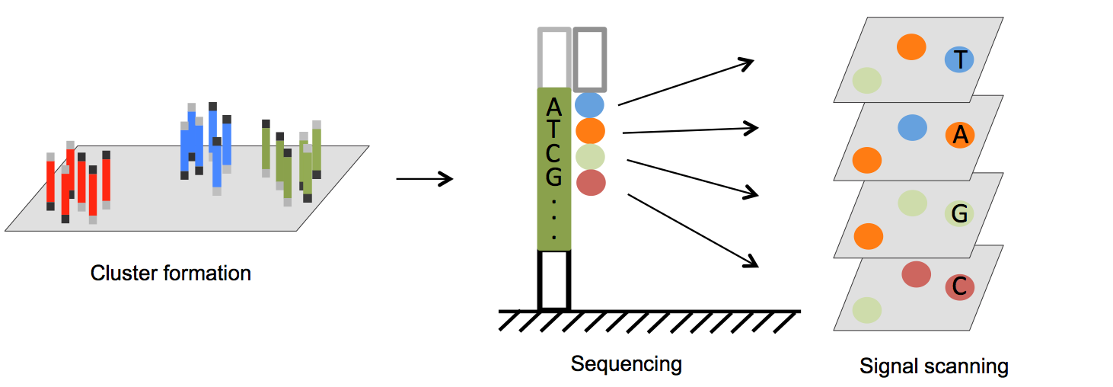
How does Illumina work?

Slide 10
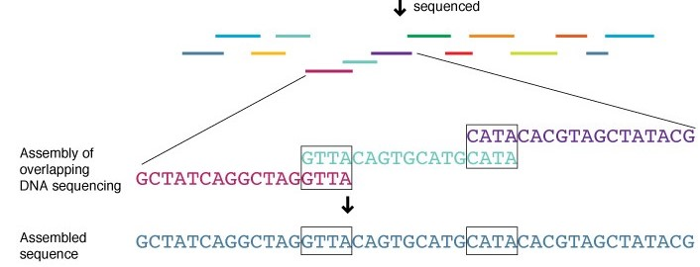
How do you assemble a genome?

Slide 11
Can you use comparative genomics to differentiate between species?
Yes, and for microbes 16S rRNA works very well!

Slide 12
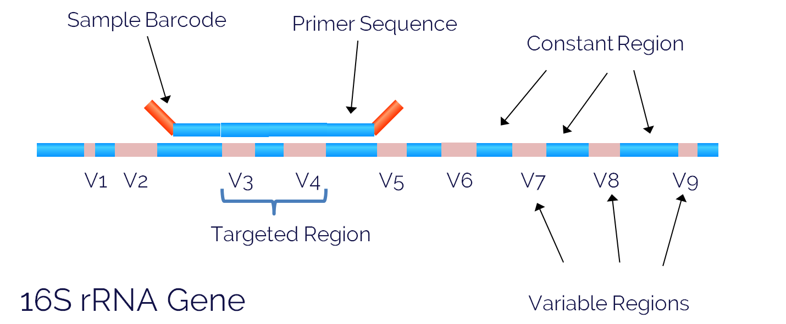
Why 16S rRNA?
Conserved and variable regions!

Slide 13
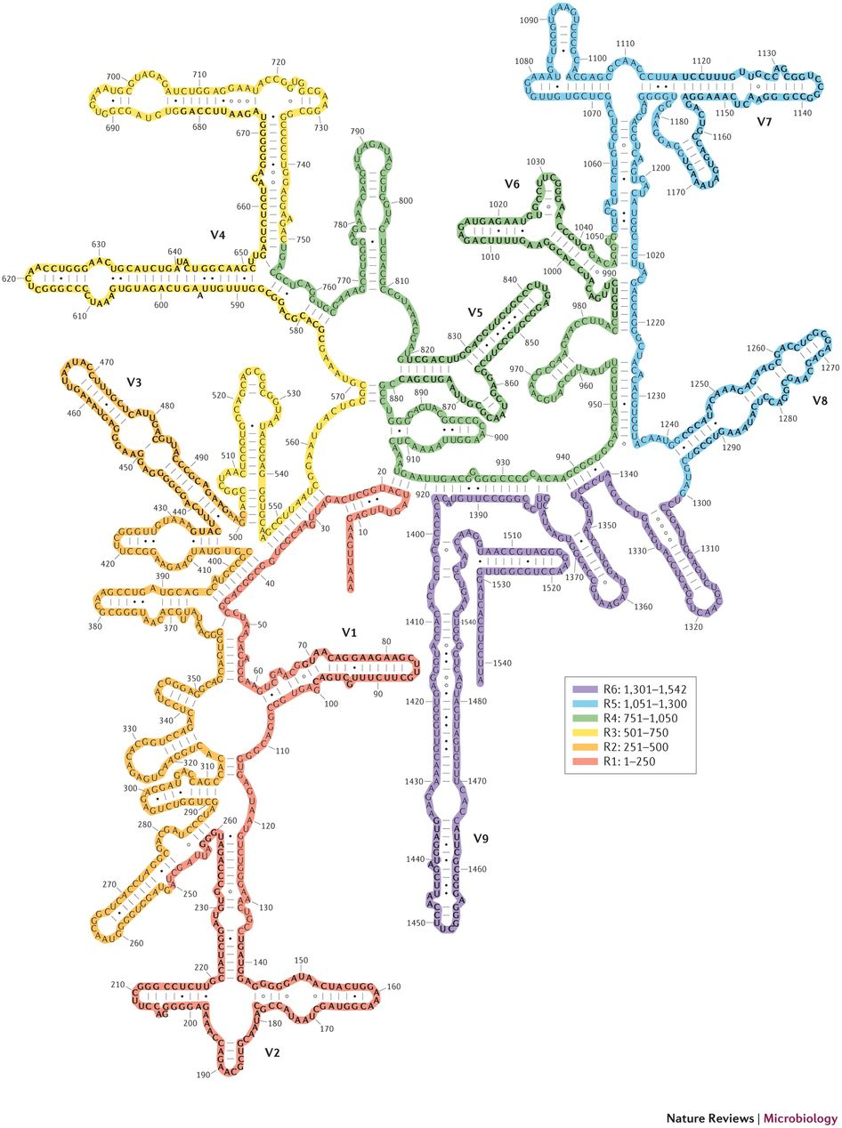
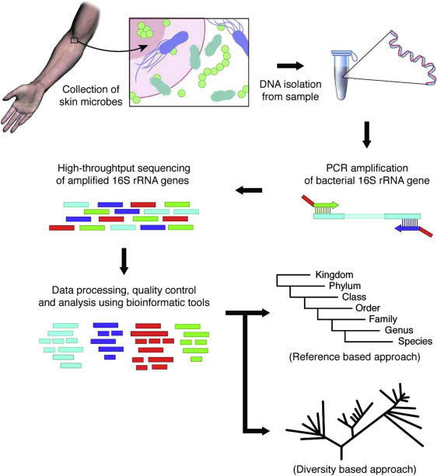
How can we leverage this region?

Slide 14
Can we classify bacteria in your gut?

Slide 15
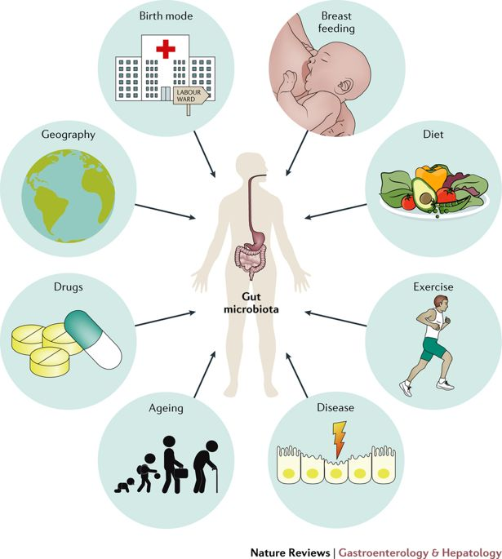
What influences gut microbiota?

Slide 16
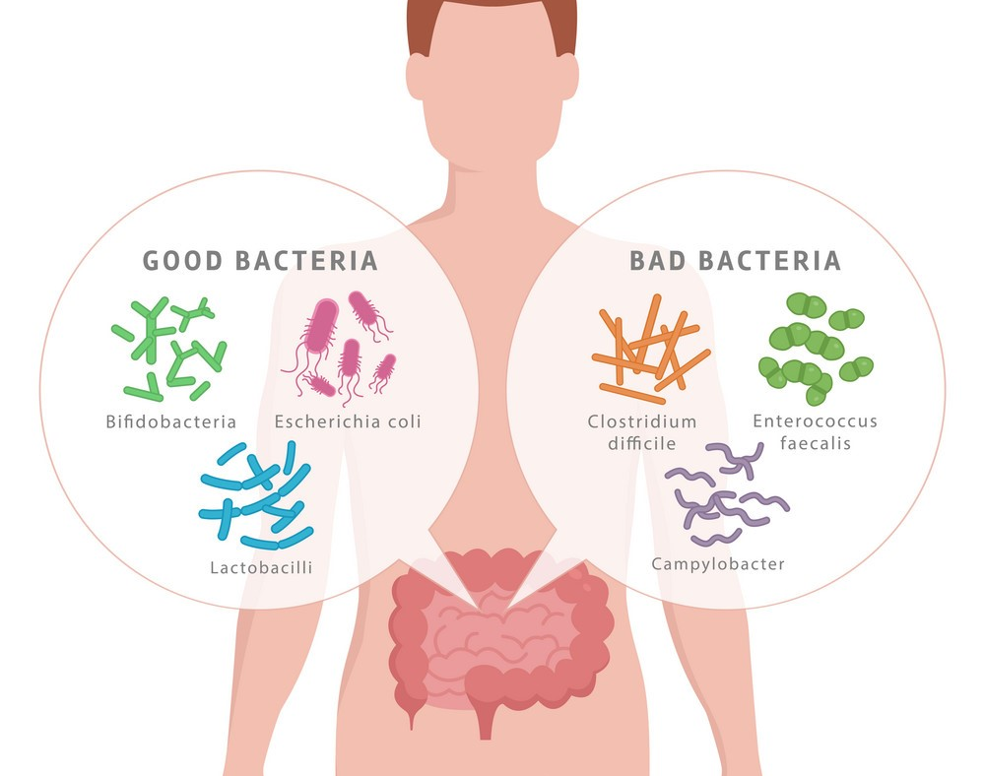
What happens when you have an imbalance?
Dysbiosis

Slide 17
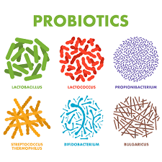
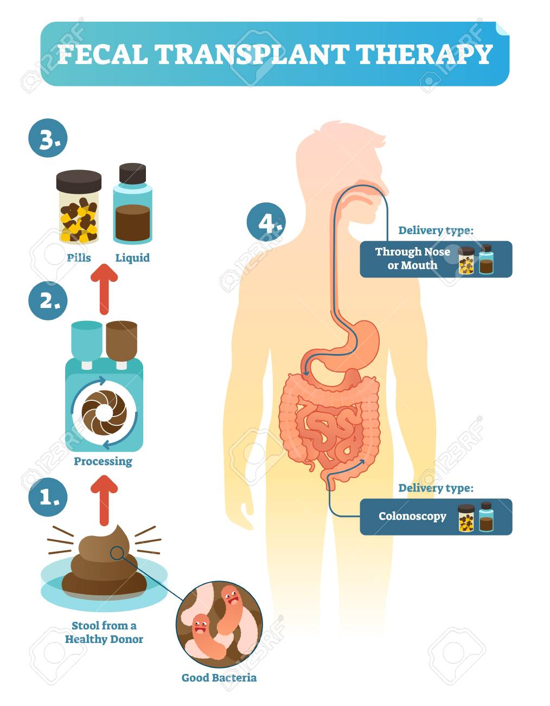
How can you fix dysbiosis?

Slide 18
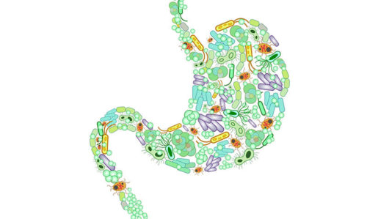
Summary
Next generation sequencing vastly increases the amount of information we can collect
16S rRNA sequencing allows us to distinguish between bacteria
An imbalance between your gut microbiome creates disease states

Slide 19
Cultured gut microbiota from twins discordant for obesity modulate adiposity and metabolic phenotypes in mice Ridaura, et al., 2013

Slide 20
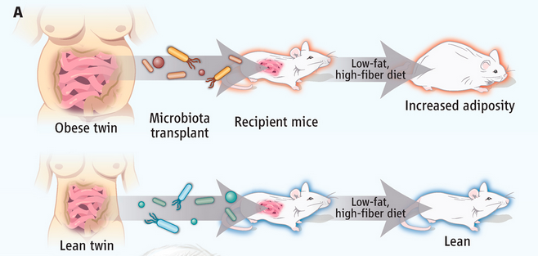
How did they perform this experiment?
Fecal samples from four pairs of female human twins were transplanted into the gut of germ free 8-9 week old male mice.

Slide 21
What were the requirements for the twin pairs?
The obese twins had a BMI of at least 30kg/m², while their twin sister’s BMI was a minimum of 5.5kg/m² lower.
DZ = Dizygotic
MZ = Monozygotic

Slide 22
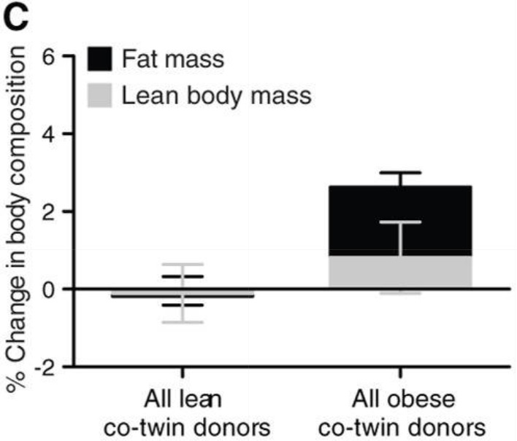
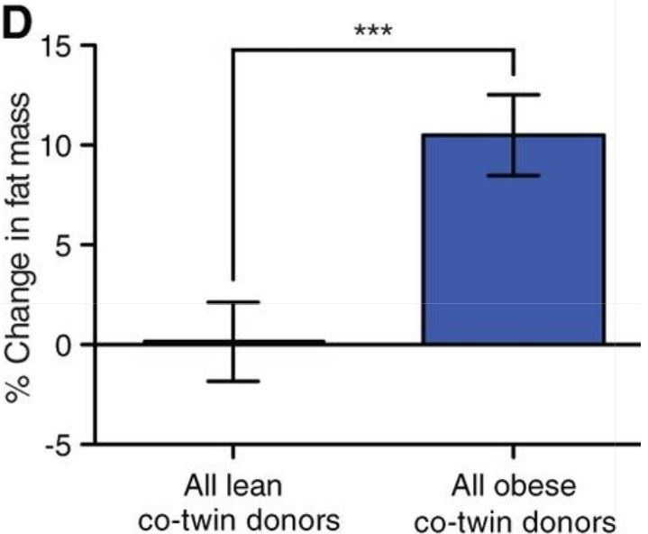
How did the mice’s body composition change 15 days after colonization?
NO change
increase in fat mass
There is a significant donor effect on fat mass

Slide 23
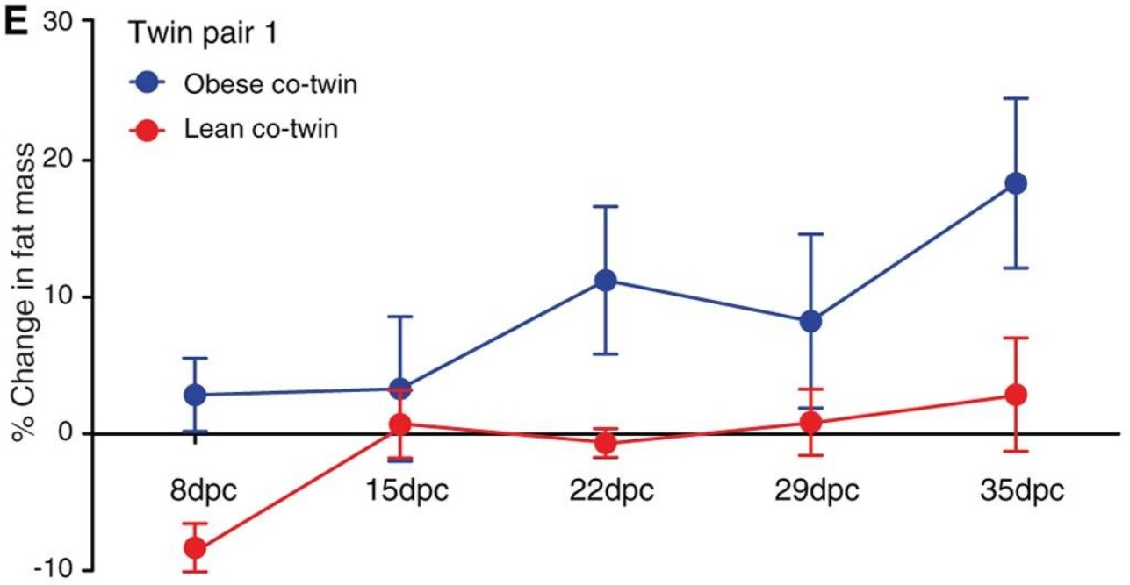
Does fat mass continue to increase over a prolonged period of time?
dpc = days post colonization

Slide 24
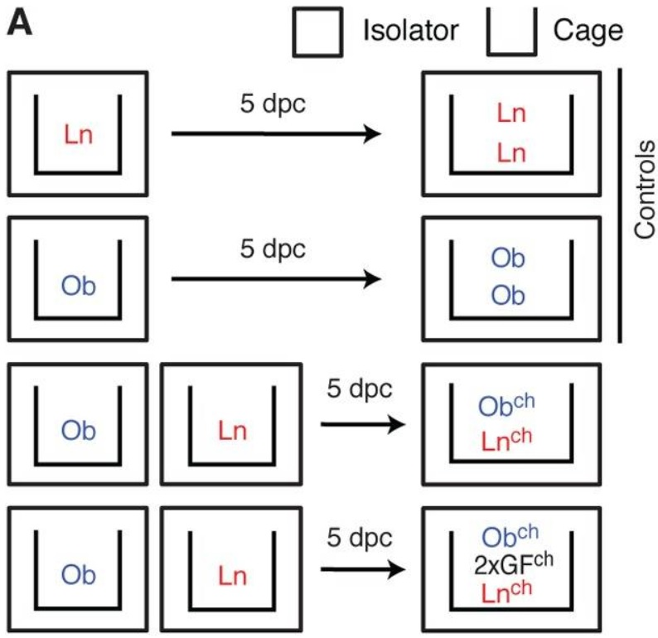
The co-housing experiment design
Ln = Lean
Ob = Obese
Ob^{ch} = Obese (co-housed)
Ln^{ch} = Lean (co-housed)
GF^{ch} = Germ Free (co-housed)

Slide 25
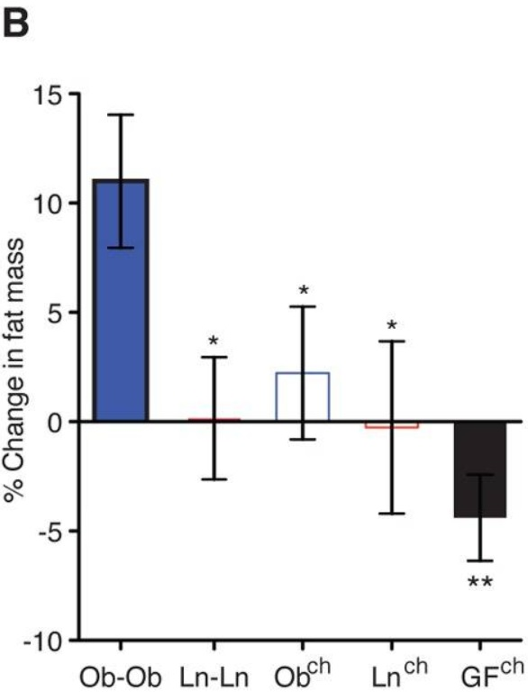
Does co-housing affect fat mass?
increase in fat mass
Ob^{ch} had increase that was less than half obese mice

Slide 26
How does living with LEAN mice prevent OBESE mice from getting fat?
Mice are coprophagic; they eat feces.
The microbiota from the Ln^{ch} mice are infiltrating the gut of the Ob^{ch} mice.

Slide 27
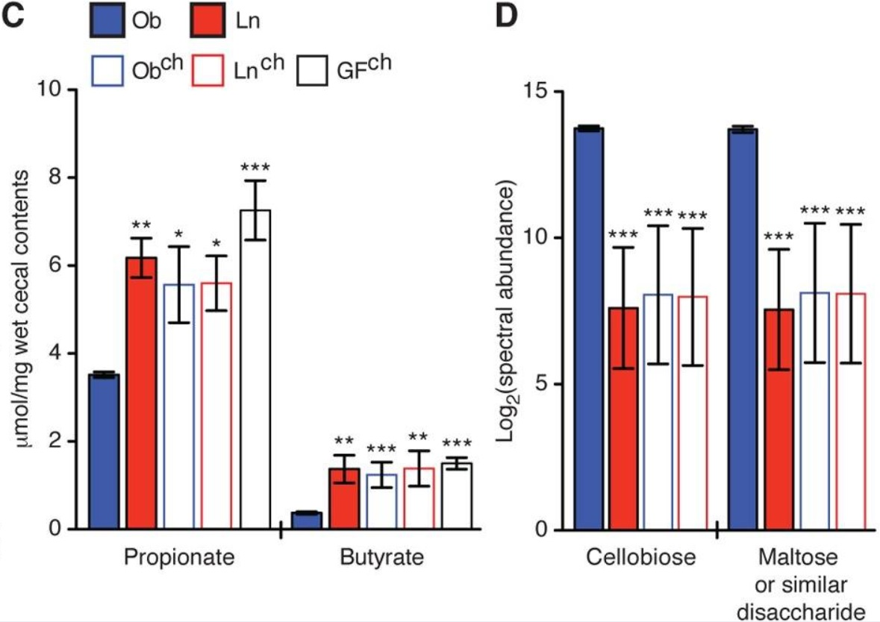
How are the fecal contents different?
Ob mice have significantly higher levels of sugar in their cecum.
Ob mice have relatively low concentrations of short chain fatty acids.
Butyrate is the primary source of energy for epithelial cells in the colon.

Slide 28
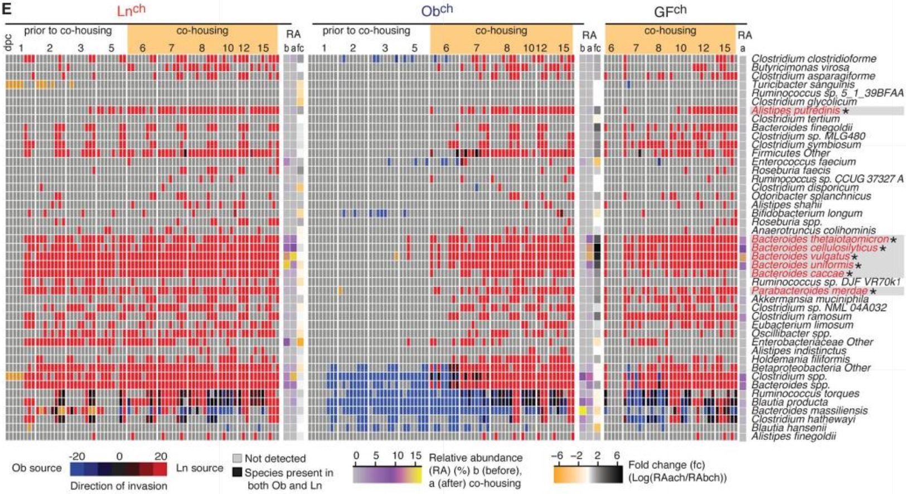
Why do the Obese^{ch} mice resemble the Lean^{ch} mice?
Invaders*
Bacterial species with an asterisk are successful invaders.

Slide 29
What is a successful invader?
Successful invaders are present in 75% of co-housed mice
A bacteria taxon was considered a successful invader if it was present in at least 75% of co-housed mice.
The relative abundance needed to be ≤0.05% prior to co-housing, and ≥0.05% after co-housing.

Slide 30
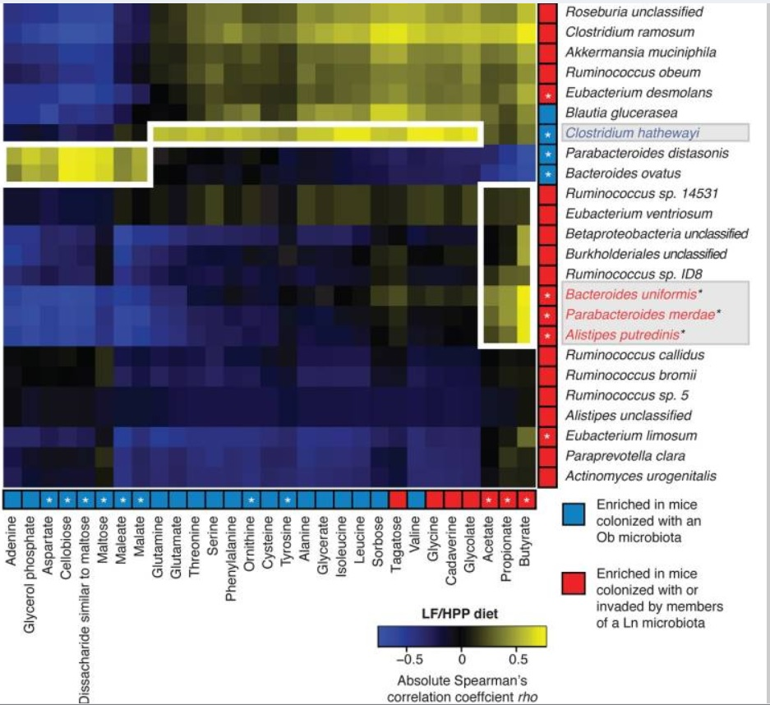
Are certain metabolites correlated to specific bacteria?
Sugars=OBESE
Short chain fatty acids=LEAN

Slide 31
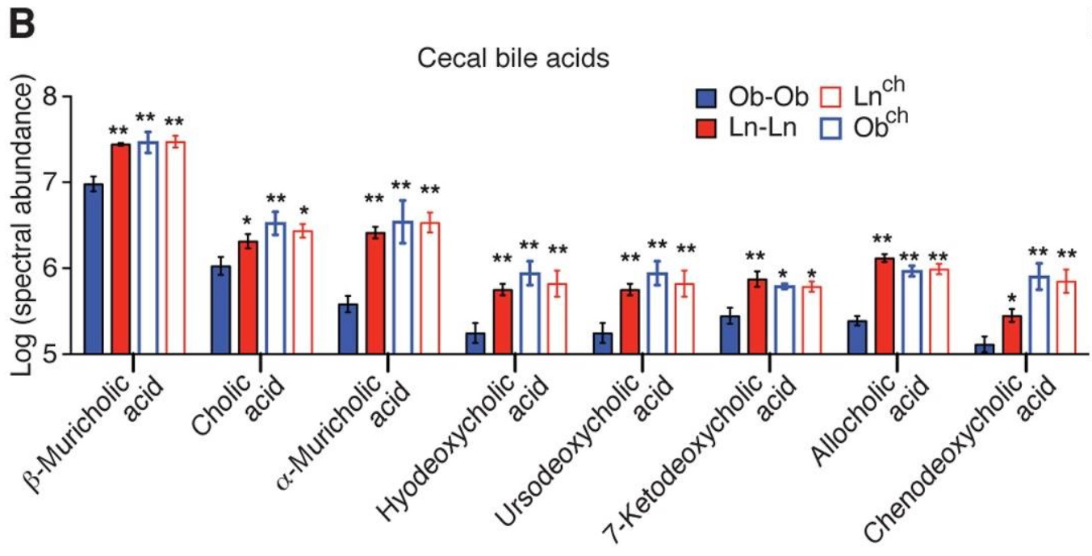
Why are bile acids important?
Bile acids are needed to absorb vitamins and eliminate cholesterol.

Slide 32
Do microbiota affect mRNA levels?
These 3 proteins are involved in a signaling pathway

Slide 33
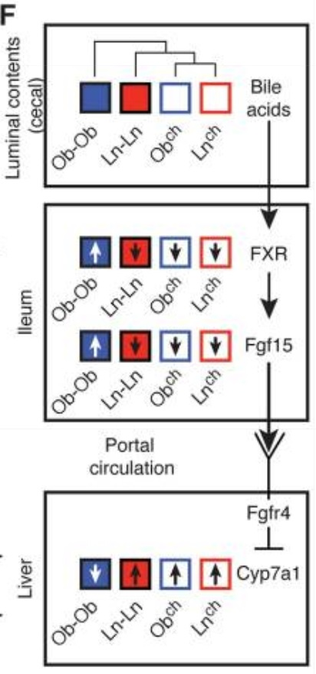
Why is this BILE ACID synthesis pathway important?
Cyp7a1 is known to prevent obesity and insulin resistance

Slide 34
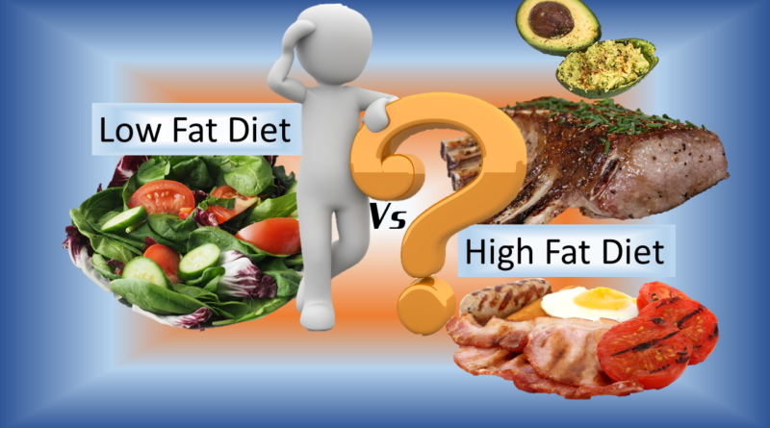
How did they test for diet specific effects?
They fed all mice a low fat, high fruit and vegetable diet.
Then they repeated the experiment with a high fat, low fruit and vegetable diet.

Slide 35
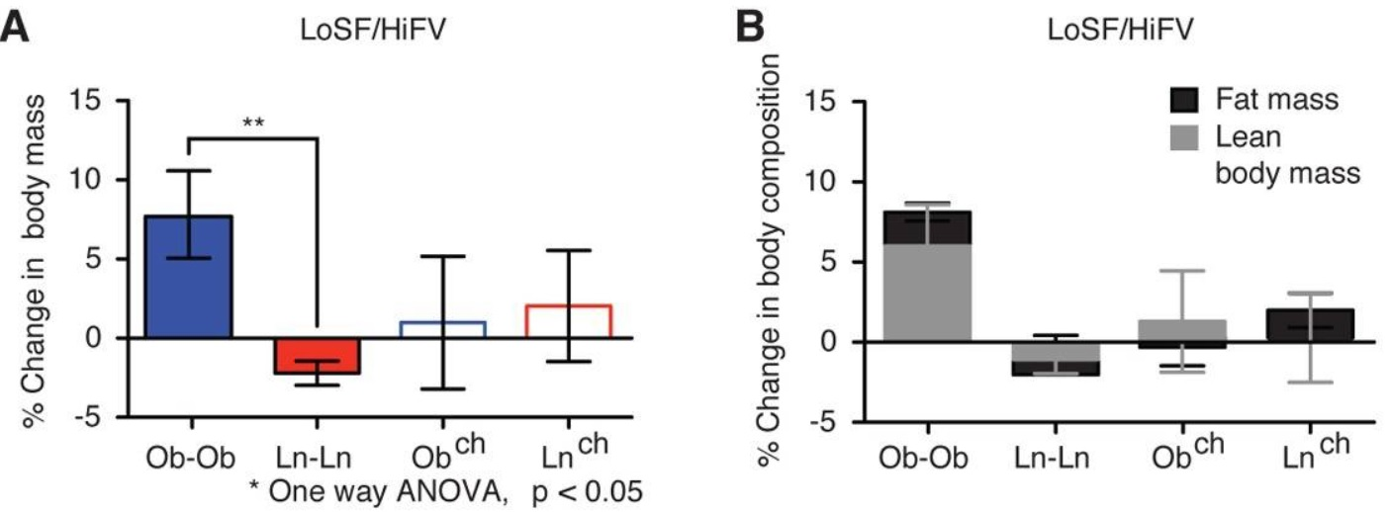
Are there diet specific effects?
Co-housing reduced weight gain for obese mice on LoSF/HiFV diet
With a healthy diet, co-housing prevents the Obch mice from gaining excessive amounts of adipose tissue.

Slide 36
Are there diet specific effects?
A low fat diet is necessary to rescue the obese phenotype

Slide 37
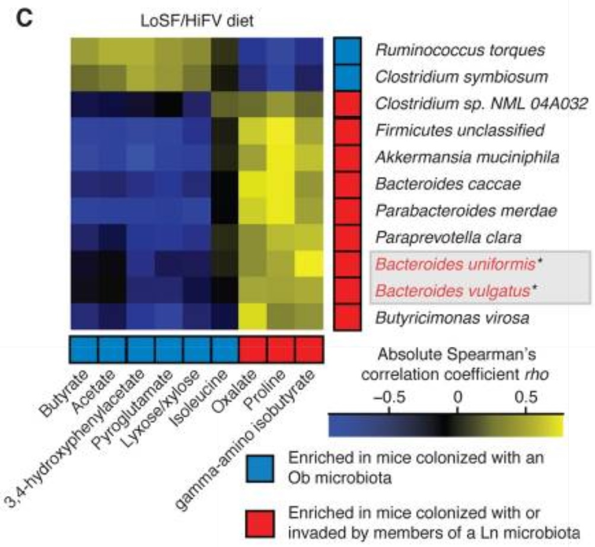
Enriched Bacteria Species
Fecal samples from lean mice are enriched with successful invaders

Slide 38
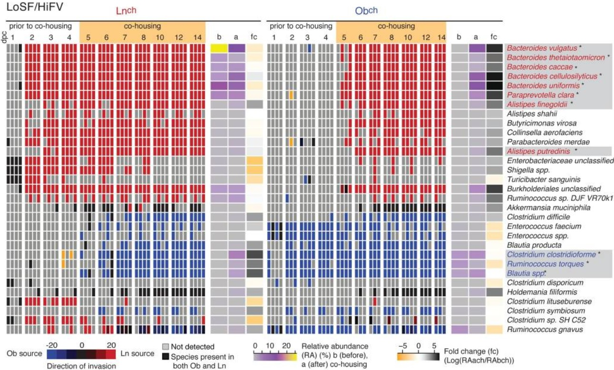
Which source had more successful invaders?
Most successful invaders came from the Ln source
This data is from 16S rRNA analysis of fecal samples from mice with the healthy diet.

Slide 39
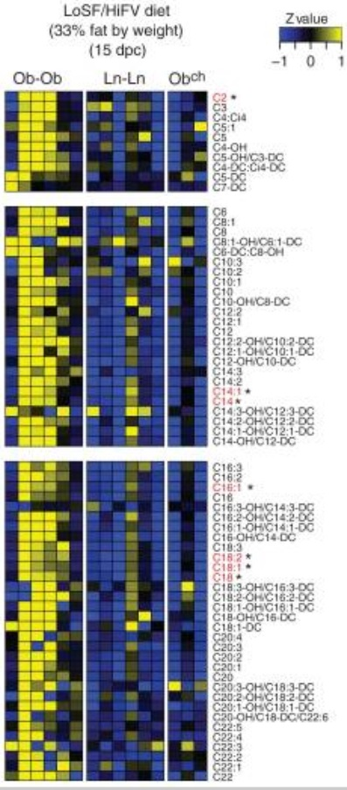
How are acylcarnitine levels affected?
Obese mice have more acylcarnitines
Acylcarnitines are associated with obesity-related insulin resistance
Insulin resistance disrupts glucose homeostasis and causes metabolic problems.

Slide 40
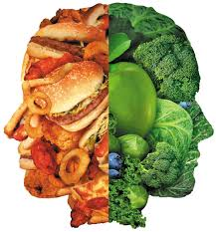
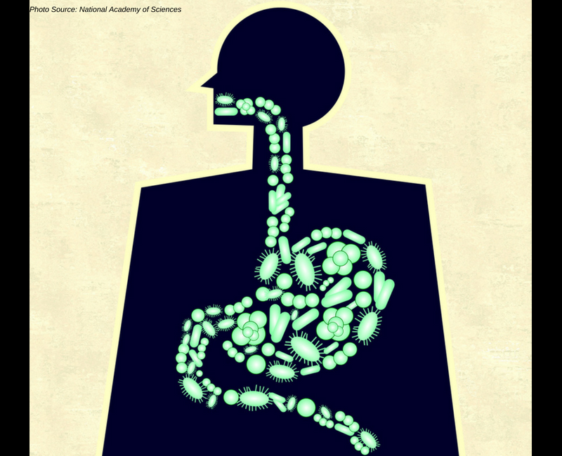
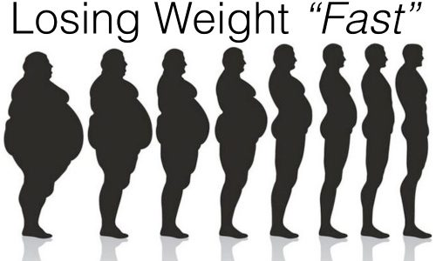
Main Conclusions of the Paper
Co-housing allows the microbiota from the lean twin to prevent the mice with the Ob microbiota from becoming obese with metabolic problems.
The phenotype rescue is dependent on a low fat diet.
This indicates that diet-by-microbiota interactions can have fast acting, modifiable effects on the body!

Slide 41
Would you sell your poop?
The OpenBiome stool bank gives $40 per stool donation!
Fecal microbiota transplants fight off C. difficile infections

